Slide 1
RINSD
Monitor Your Connection

Slide 2
Index
IoT Background
RINSD Features
Identify your IoTs
Catalog your connections
Use RINSD API to monitor your connection
Get latest vulnerabilities
Identify
Catalog
API
CVE

Slide 3
Identify
Use a network monitoring platform or Routing ISP Interface
ISP
https://fiber.google.com/myfiber/
MultiPing
https://www.multiping.com/download.html
Click Download MultiPing
Add Address range
Identify
Catalog
API
CVE

Slide 4
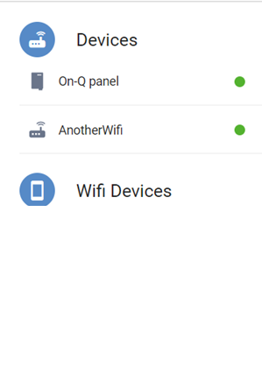
Identify
Review Connections
Count IoT devices used
Compare count
Identify gaps
Manually add additional IoT
Device Name: Device Version
Device Name: Device Version
Device Name: Device Version
Identify
Catalog
API
CVE

Slide 5
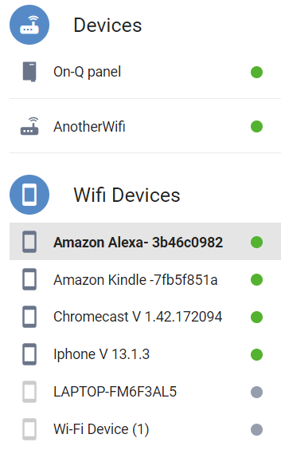
Identify
Identify IP device mapping
Identify connection points
Disconnect / Reconnect
Assess physical IoT device
Update and visit manufacture site
Rename device with version
Identify
Catalog
API
CVE

Slide 6
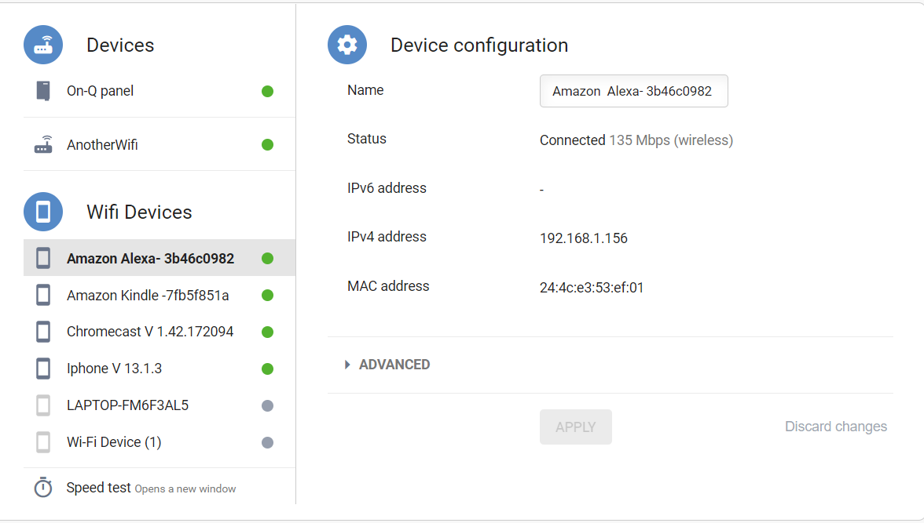
Identify
Note:
IP addresses are made up of binary values and drive the routing of all data over the Internet. IPv4 addresses are 32 bits long, and IPv6 addresses 128 bits long.
Add IP, Name and Version to RINSD catalog.
11.1111.11
Identify
Catalog
API
CVE

Slide 7
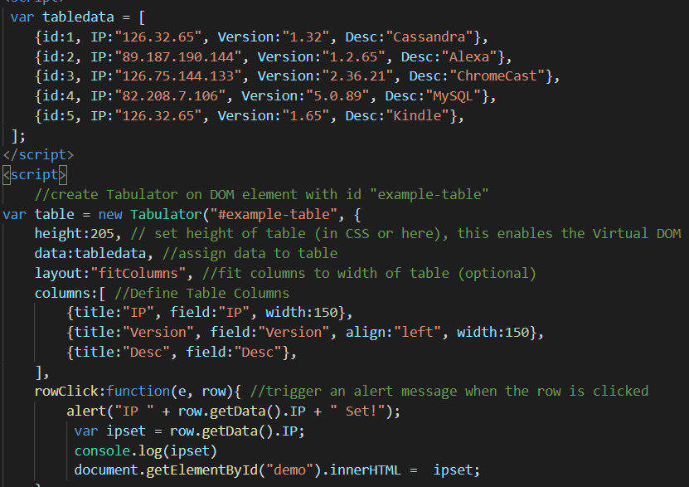
Catalog
Catalog your identified devices by filling out the table information in the catalog.html file
Identify
Catalog
API
CVE

Slide 8
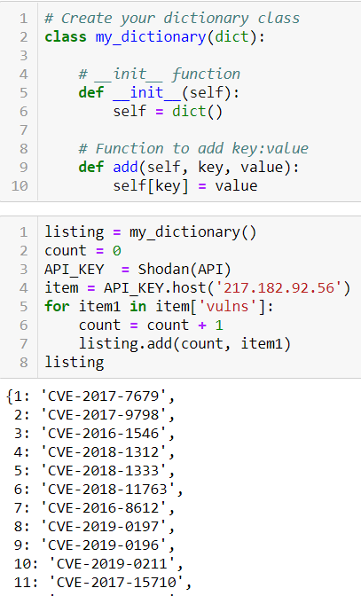

RINSD API Monitoring
The IP check button on the RINSD landing page will take your IP addresses and search through Shodan for any vulnerable device exposures. In addition if you are searching for a database or device you may discover a list of CVE (Common Vulnerability and Exposure)
Identify
Catalog
API
CVE

Slide 9
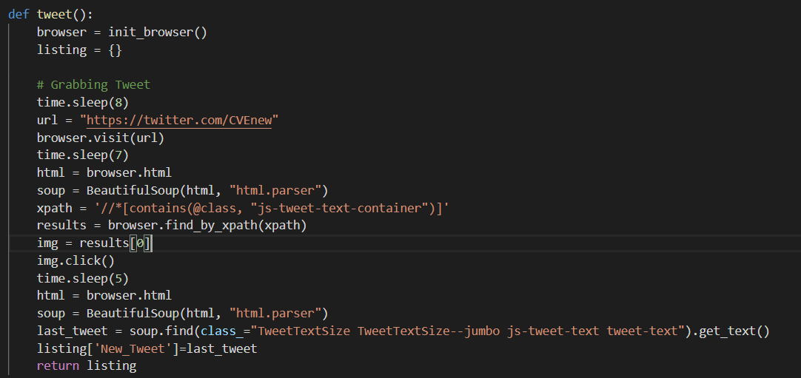

Twitter Update
The CVE checker will visit https://twitter.com/CVEnew, take the latest tweet store it in MongoDB and place it on the landing page of RINSD
Identify
Catalog
API
CVE

Slide 10
Toolbox
MongoDB
BeautifulSoup
Selenium WebDriver
Python/Jupyter
Flask
Jinja2
JavaScript
HTML
CSS
Achilles Shodan Wrapper

